Slide 1
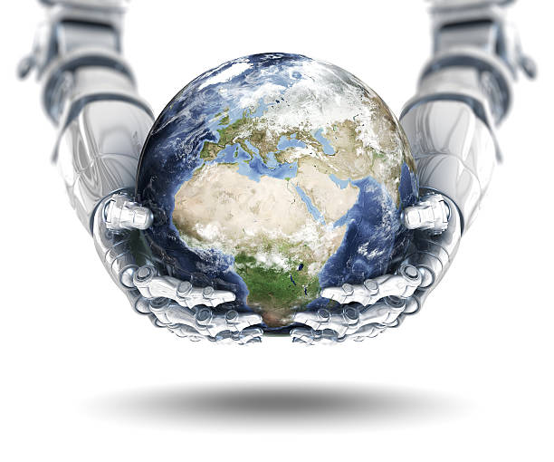

TEAM 53221 – INNOVATION PROJECT
The Hive Bus

Slide 2
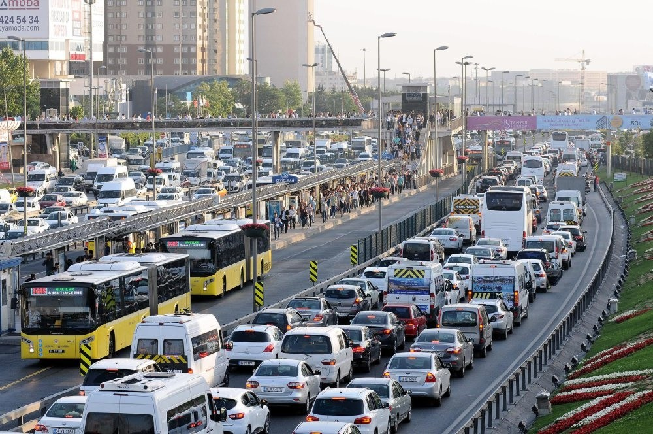

THE PROBLEM
Traffic Congestion is a major problem in the modern world.
Productivity loss, pollution, and frustration are just a few of the severe implications that traffic congestions creates.
Public transportation could have been a solution, but unfortunately, due to the inconvenience involved many drivers keep choosing their private car as their main commuting mean
Being stuck in traffic Jam can be very frustrating
Using public transportation is not very convenient

Slide 3
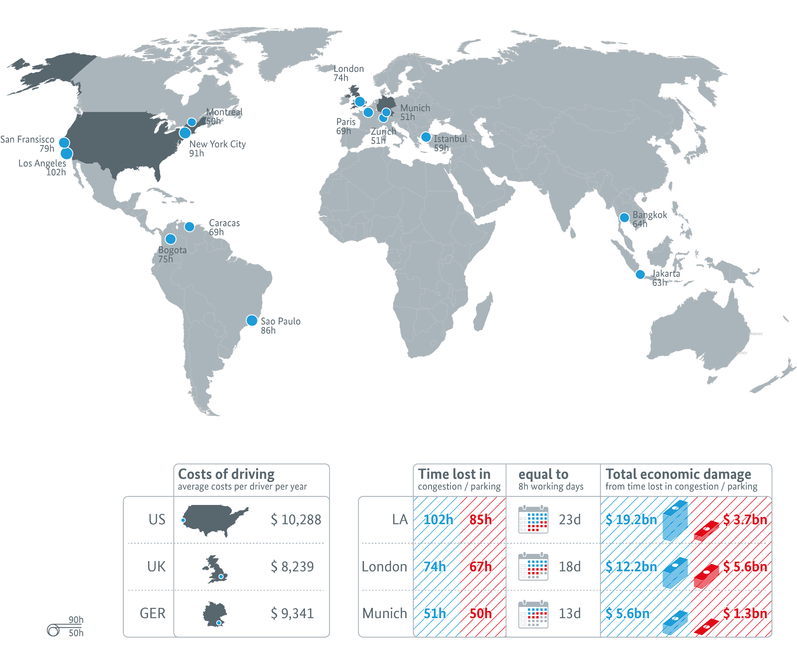
TIME LOSS AND ECONOMIC DAMAGE STATS
Area | Loss in billions | Note
USA | $305 ^{[22]} | ^{[23]}
UK | $52.01 | ^{[24]}
NYC | $33.7
LA | $19.2 | ^{[25]}
Manila | $18.615 | ^{[26]}
Bangladesh | $11.4 | ^{[27]}
SF | $10.6
Atlanta | $7.1
Jakarta | $5 | ^{[28]}
Dhaka | $4.463 | ^{[29]}
GTHA | $3.3 | ^{[30]}
https://en.wikipedia.org/wiki/Traffic_congestion

Slide 4
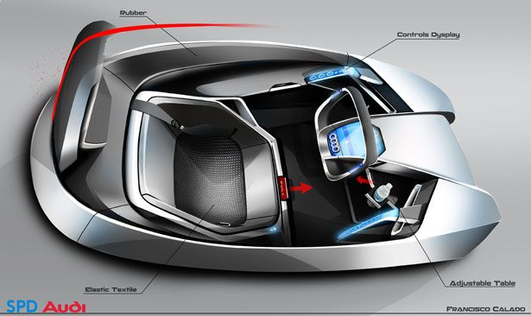
OUR SOLUTION – THE HIVE BUS
The Hive BUS is a revolutionary concept that would allow to achieve the public transportation efficiency while enjoying the private car conveniency
Instead of using a big polluting car to take each commuter all the way from his home to his final destination, drivers would use a hexagon shaped tiny electrical car (Hexa-Car) that would be driven for short distance from the home to the township central station. There, it would magnetically snap into a hive of many other Hexa-Cars to form together a virtual bus body that would be towed by a “Bus Puller” and would all together be called the Hive-Bus
The Hive Bus, driven by the puller driver, would then make its way to the next station by making use of the public transportation restricted lanes. When getting to the station, the Hive-Bus would quickly collapse and re-form with other group of hexa-cars that are headed to the same next station.
When the Hive-Bus would get to the destination city center – the commuter with his Hexa-Car would separate from the hive and would make his way to his final destination by driving hiss electric convenient Hexa-Car.
Finally, he would leave his Hexa-Car in an automated parking lot in his office building and take the elevator to his desk. And here the commuter made to his destination without ever leaving his beloved convenient, dry, cozy Hexa-Car.

Slide 5


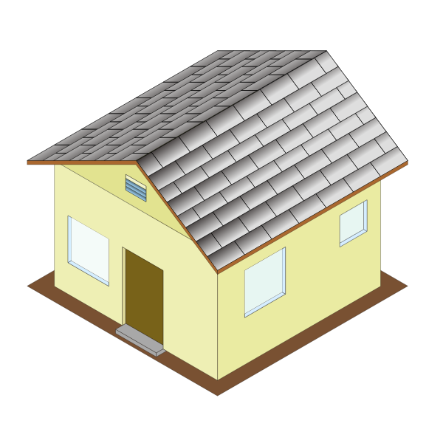



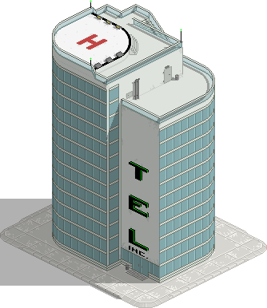
COMMUTE CYCLE
Langley
Vancouver
Automatic
Parking
Surrey

Slide 6
ADVANTAGES
Efficient
Minimal footprint of each commuter on the road would relief the congestions and would allow many more commuters on the existing roads
Convenient
A commuter would stay in his private cozy Hexa-Car during the entire commuting cycle from leaving his home to his desk office
Clean
The Hexa-Car would be propelled by electricity which would reduce air pollution
Productive
The commuter would be free to work or to rest while being snapped into the Hive-Bus as the driving is done by the Hive-Bus driver
Productive
The commuter would be free to work or to rest while being snapped into the Hive-Bus as the driving is done by the Hive-Bus driver
Automatic parking
The Hive-Cars would be built to be parked automatically in the most efficient way without the need to look for parking and with minimal parking footprint
Easy Navigation
The station routing and the Hive-Bus forming would be done automatically by dedicated computer software

Slide 7
THE HEXA-CAR

Slide 8
Bus Efficiency with Car Conveniency.
So, the idea is that cars in the form of hexagons, shall combine and create a bus like type of transportation. And instead of each bus moving individually much like cars, the bus will be much like the air control center, the ACC, each bus will know where the other buses are to avoid collision and traffic. And it will also be powered by electricity meaning it will also help the environment.

